Slide 1
Drug Prediction
Group one- Detectives
Jacky Yang
Khasim
Haoyang Sang
Charlotte Higgins Iati

Slide 2
Business Understanding

Slide 3
60% of Employers are not Drug Testing
“For some employers the cost to find a single drug user can be high… a positive test result cannot
determine use or impairment at work and [that there’s a] general lack of evidence that drug testing
has an impact on performance or safety.”
- Michael Frone in his book Alcohol and Illicit Drug Use in the Workforce and Workplace

Slide 4
According to the National Council on Alcoholism and Drug Dependence, Inc. (NCADD), drug abuse costs employers $81 billion annually.
70 percent of the estimated 14.8 million Americans who use illegal drugs are employed

Slide 5
Companies who drug test are spending money on job candidates that are not taking drugs
Accommodations and Food Services
19.1%
Past month illicit drug use among adults ages 18-64 employed full time, by job category
2008-2001, SAMHA, Center for Behavioral Health Statistics and Quality
National Survey on Drug use and Health
Management
12.1%
Professional, Scientific, and Professional Services
9.0%
Other Companies who are not drug testing because money is being wasted
Finance and Insurance
6.5%

Slide 6

We aim to drug test people according to their specific risk
Who is at risk for taking drugs?
01
Based on personality traits and use of legal substances such as caffeine, alcohol, and nicotine
What drugs are they are risk for taking?
02
So that we can drug test accordingly and eliminate the cost associated with sick days, lack of productivity, and inefficiencies due to drug using employees
03
What type of drug test should they be given?
To eliminate over- or under- spending on drug testing

Slide 7
There are different costs associated with different degrees of drug tests
Hair
$100
90+ Days
All
Drug Use
Urine
$50
~60 Days
Marijuana, Cocaine, Amphetamines, Opioids
Drug Use
Saliva
$70
~7 Days
Marijuana, Cocaine, Amphetamines, Methamphetamines
Drug Impairment
Blood
$200
~3 Days
All
Drug Impairment
Price
Detection Window
Drugs Tested
Purpose

Slide 8
Data Understanding

Slide 9
UCI Drug Consumption Data Set
Personality Traits
Use of Legal Drugs
NEO-FFI-R (neuroticism,
extraversion, openness to
experience, agreeableness, and
conscientiousness), BIS-11
(impusivity), and ImpSS
(sensation seeking)
Alcohol, chocolate, caffeine, nicotine
UCI DRUG CONSUMPTION
Demographic Information
Use of Illegal Drugs
Level of education, age, gender, country of residence, and ethnicity
Amphetamines, amyl nitrite,
benzodiazepine, cannabis,
cocaine, crack, ecstasy, heroin, ketamine, legal highs, LSD,
methadone, mushrooms, and
volatile substance abuse and
one fictitious drug (Semeron)
Notes:
No missing values

Slide 10
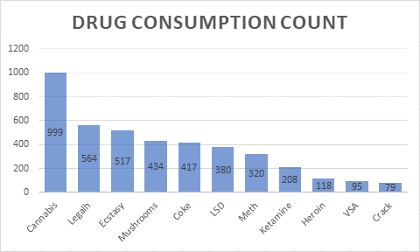
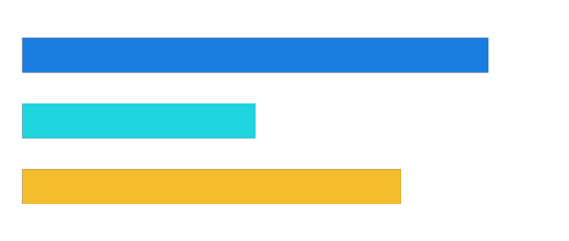
Drug Consumption Layout
Over half of the participants in our data set has taken drugs in the last year
59%
41%

Slide 11
Data Prep

Slide 12
Our model building process for a
multi-classification problem
Reclassify Frequency
Clean data
Model Creation
Deployment
Evaluation
Reclassify drug usage to fit our needs
k-NN, logistic regression, tree induction
Determine best model for each prediction
Splitting, resampling, deleting insignificant variables

Slide 13
Data Cleaning
01
Reclassify Drug Use
“Potential user” if taken in the last year or more recently
“Non use” if taken in the last decade or less recently
02
Resample for Rare Classes by Upsampling
Coke, Ketamine, LSD, Heroine, Meth, VSA
03
Delete Insignificant Data
Delete drugs that created to curb over-reporting of drugs (Semler)
04
Categorized Drugs as “Legal”
Cannabis, Coke, Crack, Ecstasy, Heroin, Ketamine, Legalh, LSD, Meth, Mushrooms, VSA
05
Categorized Drugs as “Illegal”
Alcohol, Amphetamine, Amyls, Benzos, Caffeine, Nicotine

Slide 14
Model Building

Slide 15
Facets of our Model
Target Variable
“Risk” for each individual illegal drug
A person is coded as “risk” if they are predicted to have taken a drug one year or less ago and “not risk” if they are predicted not to have taken the drug in the past year
Predictor Variables
Personality Traits Legal Drug Use
Grid search determines proper parameters and weights
Algorithms
K-NN Logistic Regression Decision Tree
Parameters chosen through gridsearch, model chosen through cross validation
Notes:
We coded a person as risk if they are predicted to have taken a illegal drug one year or less ago and not risk if they predicted not to have taken the drug in the past year
We only use training and test dataset.
One thing we want emphasize is that this is a multi-classification problem and people can take multiple drugs at the same time, so we need to make predictions on all illegal drugs one by one, allowing users to pinpoint exactly what kind of drugs the candidates are using.

Slide 16
We created individual models for each drug based on...
Choosing Best Model
Problems with Model
Potential Model Improvements
We chose the best model for that specific illegal drug based on which model had the smallest recall and highest AUC
Our goal is minimize false negatives
There was too little data to minimize false predictions beyond our values
We would prefer if the false negative rate was lower
More data would better inform the distinctions between classes
Varied data sets would eliminate overfitting to the sample
Notes:
do we want to talk about we need to do more feature transformations?
More diversity in term of country original and race.
Pros: minimize false negatives
Cons: computationally heavy doing prediction on all illegal drugs, try different classification approach
Realized the data is not the most representatitve
Instead of using accuracy as main criteria

Slide 17
Evaluation

Slide 18
Evaluation Metrics Across All Target Variables
 |  |  |  | We measured the average evaluation metrics after creating models that analyzed the drug use risk for each individual drug...
01 | Average AUC Score on all target variables |  | 82%
02 | Average accuracy on all target variables |  | 94%
03 | Average recall on all target variables |  | 71%
04 | Average F-Measure |  | 75%

Slide 19
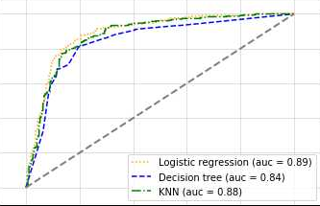
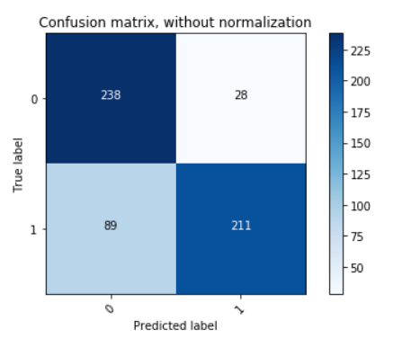
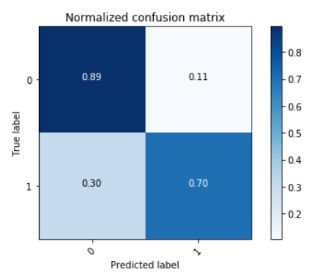
Cannabis Model
AUC
Based on the AUC, the logistic regression model is the best predictor of the risk for cannabis use.
This results in the collection of 211 cannabis users out of 300 total users. The positive recall is 70%.
Accuracy: 79%
AUC: 89%
Recall: 79%
Precision: 81%
F-Measure: 79%
Confusion Matrix
Normalized Confusion Matrix

Slide 20
Cannabis Model in Accomodation and Food Services Industry
01 | With the model, we can reduce 71% of the total drug users |  | 71%
02 | We assume there are 14% of the food industry that uses cannabis |  | 14%
03 | Average annual salary paid on the industry |  | $21,903
04 | Annual ROI on the industry |  | $601M

Slide 21
Deployment

Slide 22
Deployment Considerations
Non-Drug Testing Companies
Drug Testing Companies
Biggest Risk
Ethical Considerations
Model Needs
Based on the model for cannabis, there is a drop in risk of from 53% (is taking drug) to 16% (predicted not taking and is taking the drug)
The biggest improvement to the model would be increasing amount and diversity of data to eventually lower the false negative rate
Using the model will reduce costs associated with drug using employees
Using the model will reduce number of candidates tested, resulting in $50-100 saved per untested candidate
It may be unethical to selectively drug test people, or to target people based on their personalities or demographics

Slide 23
Thank you

Slide 24
Our Services
Getting People Drug Tested
Pinpoint the people to be tested
Minimize cost of drug users in the workplace
To eliminate the costs associated with employing someone who uses drugs
Only invest time and money into testing the candidates who are “at risk” for drug use
By capturing the job candidates that use drugs before they are hired, costs associated with hiring drug users will be diminished
Keeping Cost of Drug Tests Low
Specify the type of drug test each individual needs
Only test “at risk” candidates
To curb the fear of over spending on drug testing, specify who they need to drug test and what that individual requires
Different drugs require different tests, and those tests come at different prices
Avoiding overtesting candidates that are not likely to take drugs

Slide 25
Appendix
1.Data Cleaning
2. FOR Loop
2a. Grid Search
2b. ROC-AUC scores
2c. Selecting the best model

Slide 26
Data cleaning
Our data had labelled every positive drug user among one of six classes from CL0 to CL6
The description for these is as follows:
CL0- Never Consumed the drug
CL1-Consumed more than a decade ago
CL2-Consumed more than a year and less than a decade ago
CL3-Consumed less than a year ago
CL4-Consumed last month
CL5-Consumed last week
CL6- Consumed yesterday
We decided that classes CL1 and CL2 should be treated as non-consumers of the drug because taking the drug once or twice almost a year ago doesn’t qualify the subject as a regular user
This is why we decided to rename those classes as negative classes along with CL0

Slide 27
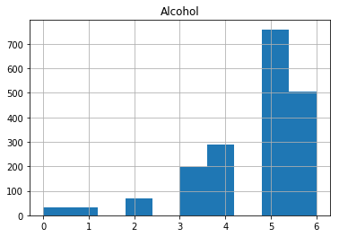
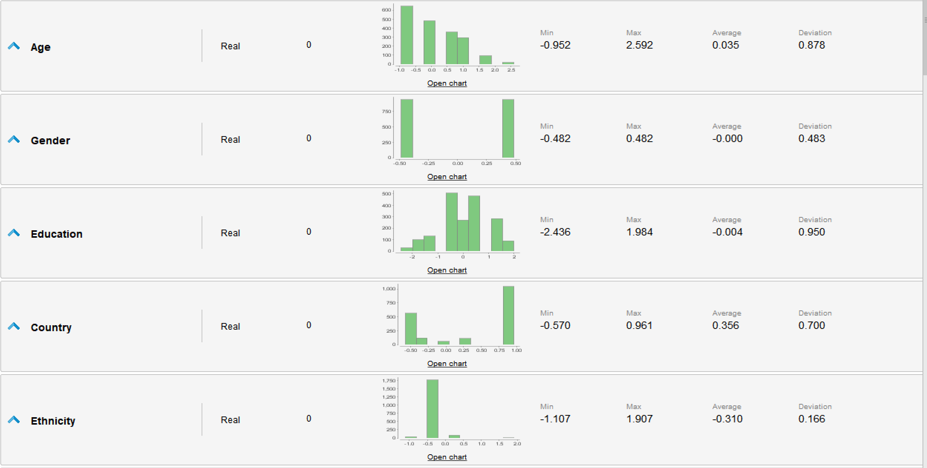
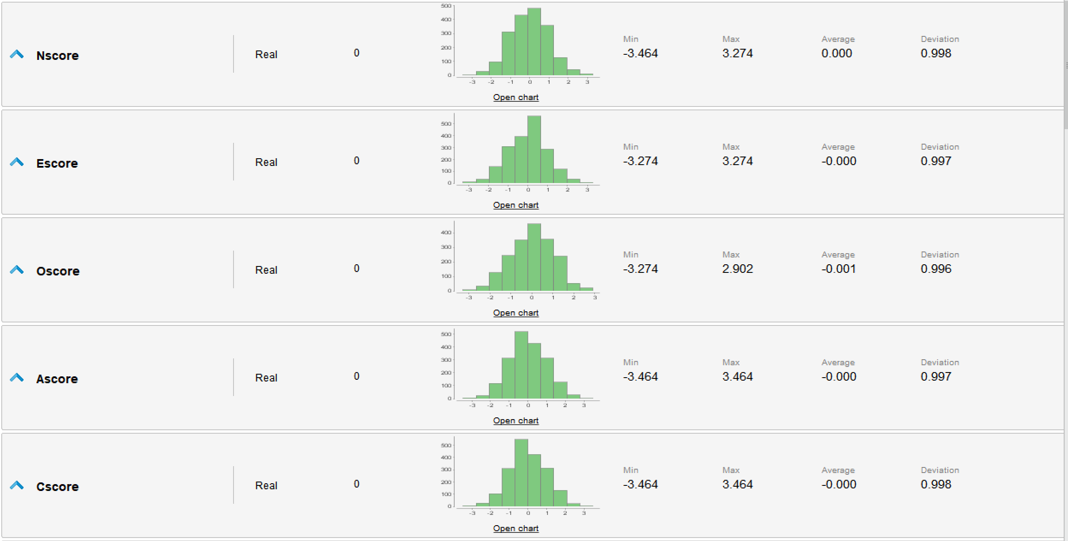
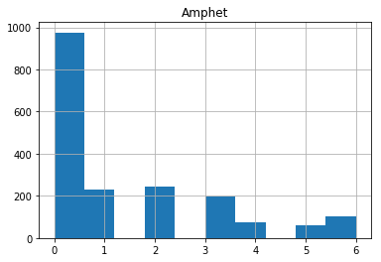

Slide 28
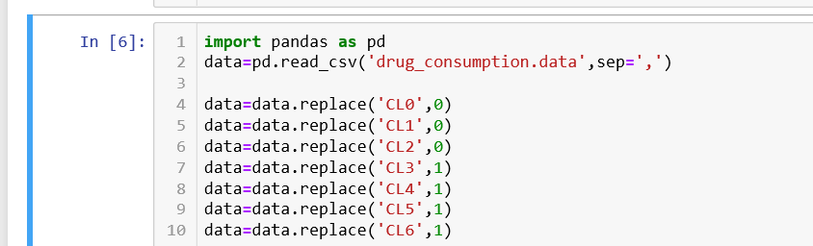
This was done as follows:
‘0’ signifies non-user and ‘1’ signifies user

Slide 29
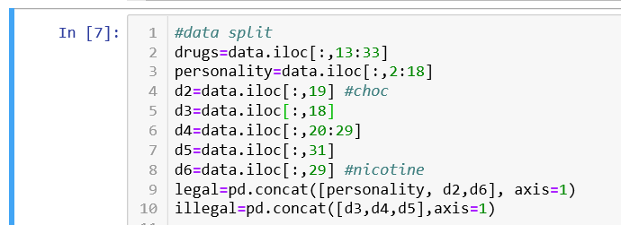
After this we split the dataset into three parts each containing:
Personality traits and subject background(personality)
Usage data of legal/prescription drugs(legal)
Usage data of illegal drugs(illegal)
NOTE: For creating the training set; the personality and legal dataframes along with columns for choclolate and nicotine consumption were merged to create a single dataframe named ‘legal’

Slide 30
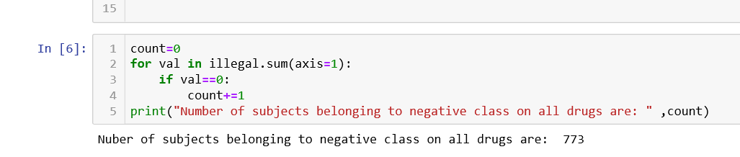
Each of the columns in the ‘illegal’ dataframe corresponds to a single target variable that our model predicts
So, our model predicts consumption for 12 illegal drugs each of which are divided into classes consumed(1) and not-consumed (0)
After this we plotted statistics to see examine what the rare classes are and how many subjects belong to the negative class on all drugs

Slide 31
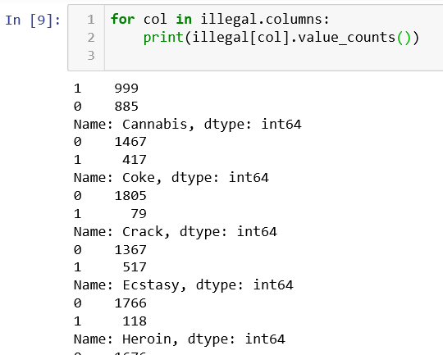
The rare classes were identified using the following code
Any class with a ratio less than 70/30 was considered as a rare class

Slide 32
ROI
the total salary pay on accommodation and food services industry is 21903 * 13.4M = 293.5 BN, and about 19.1% percentage of the salary is paid to workers with marijuana smoking history, which is about 56.1 BN. Given our technique, we could discover up 71% of the addicts in the whole industry, which involves about 39.2 BN salary payment.
If we apply the marijuana screening check on the industry’s recruiting market, then we could potentially identify 71% of the 14% weed smokers in 0.28M new recruits at almost no cost. If we could replace these new addict recruits with clean workers, then the industry could save a total salary payment of 0.28M * 14% * 70% * 21903 = $601M.

Slide 33
FOR Loop
A massive For loop, iterating over each target drug and containing the following sequence of operations was constructed:
Split the data into train and test sets and resample
Perform grid search on 3 classifiers
Calculate the ROC-AUC score using best parameters for classifier
Choose the best model for the particular drug class

Slide 34
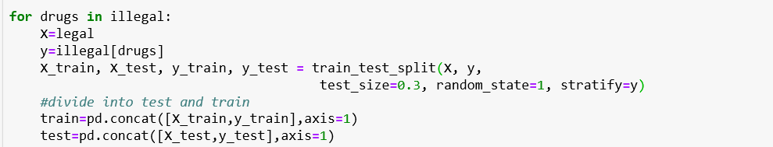
Data splitting
Note: The concatenation at the end is done for the purpose of resampling

Slide 35
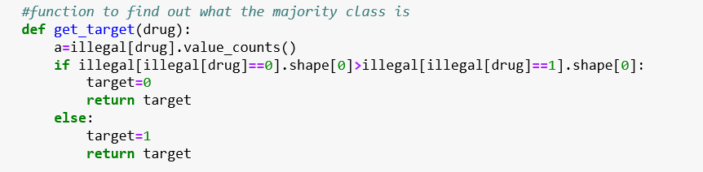
Resampling
The minority class for each drug is identified and upsampling is done. We choose upsampling because we have less data available

Slide 36
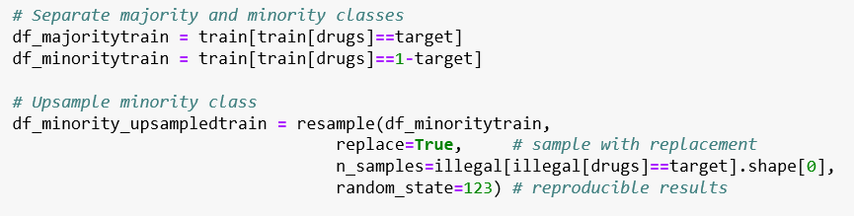
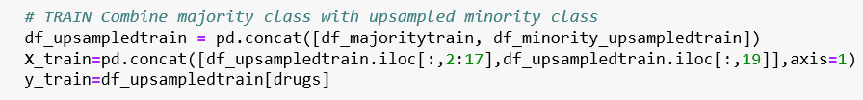
Upsampling code
The upsampled training data is combined again:

Slide 37
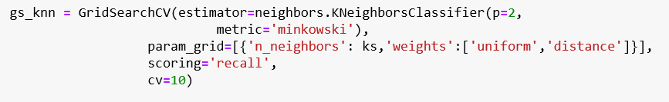
Grid Search
Grid search was done for each of the three classifiers:
Decision Tree Classifier
KNN Classifier
Logistic regression Classifier

Slide 38

scoring= ’recall’
We have used the recall score to optimise for our parameters. Grid search tries to maximise the recall score. This will result in a model that gives less number of false negatives
The best parameters generated by grid search are then saved:

Slide 39
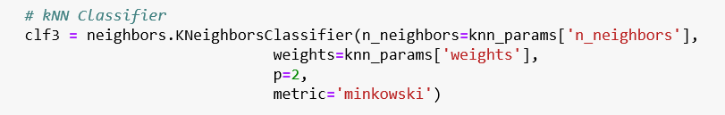
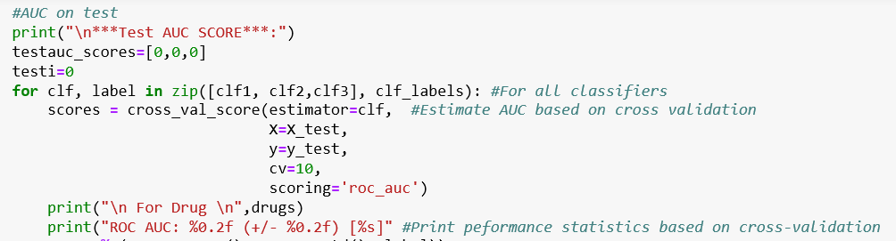
ROC-AUC Score
The best parameters for each classifier are used to calculate the AUC score for the best model

Slide 40
Selecting best model for the drug
The model with the best AUC score on test-data was selected as the best model for predicting
that particular illegal drug
The model parameters for each of these best models would be saved and then used to make predictions for each drug when a new data-instance comes in

Slide 41
Cannabis example
Based on true positives and false negatives:
Original risk: 300/566=56%
Risk after using our model: 89/566=16%
Risk Reduction: (56%-16%)/56%=71%
Confusion Matrix

Slide 42
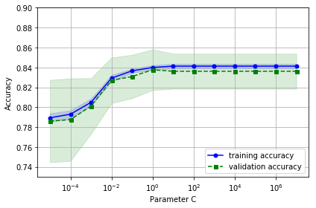
Fitting Curve
The best classifier on cannabis was logistic regression

Slide 43
END

